Slide 1
PIPBoy
Anika Roskowski, Mak Mckinney

Slide 2
Initial Testing
Modular Construction
WiFi Functionality
LCD Functionality
WiFi/LCD Integration and Compatibility
Audio Functionality
RTC Functionality
Finite State Machine Design and Debugging

Slide 3
What is the problem?
In the Fallout Video Game Universe, a nuclear bomb is dropped on the United States. The Vault Tec Company has created a wearable device that tracks wearer metrics, location, etc that also serves as the pause menu and in game radio
The device must have data to help the wearer survive in the wasteland as well as a music option to help the wearer stay current with news

Slide 4
Problem Definition
Fallout game universe
Nuclear Apocalyptic world, advanced without transistors
PipBoy – Survivor Information Hub
Player Location/General Map
Player Metrics (Health, Status Effects, & Inventory)
Quest Information/History
Radio & News
Pause Menu

Slide 5
Our Solution
Features
Theories/Concepts
User Selected Operation Modes
LCD Display
Weather Fetching
Real Time Clock
Audio Output
Instrument Selection
Finite State Machine
I2C Communication
UART Communication
API Fetching
8-bit Binary Weighted DAC
Various Timer Interrupts

Slide 6
Theories/Concepts
UART (WiFi, Debugging Prints)
I2C (LCD, RTC)
API Fetching
8-bit Binary Weighted DAC (Audio)
Finite State Machine
Systick Timer
General Register Timer

Slide 7
Metrics
Must Match Expected Behavior
Correct Output and Displays
Prints properly formatted
Correct/Most recent data is shown
Proper State Transitions
Previous state functions suspended
Correct behavior of current state
“Feel Good” Aspect
Does it look and feel good to use as a user?

Slide 8
Validation
Incremental validation of modules
Module Functionality
Invokable from Main
Finite State Machine Testing
Input stress test with state select buttons
Full System Testing
Individual functionality and proper state handling

Slide 9
Comparison To Existing
Most (if not all) Similar Real-World PipBoy projects use Python and/or SOCs with operating systems
Less game accurate than microcontrollers
Arguably less space efficient
Ours was a smaller scale, and was written on a fully embedded system without a specific operating system
A very good example of a real-world PipBoy can be seen on YouTube by Your Geek Fix: https://www.youtube.com/watch?v=j1EnScCsyhg

Slide 10
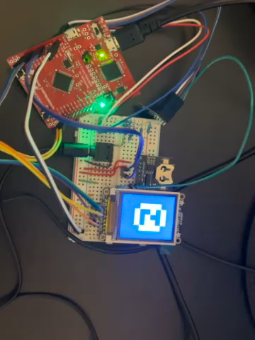
Demo
On youtube: https://www.youtube.com/watch?v=DNfblcrEts0

